Slide 1
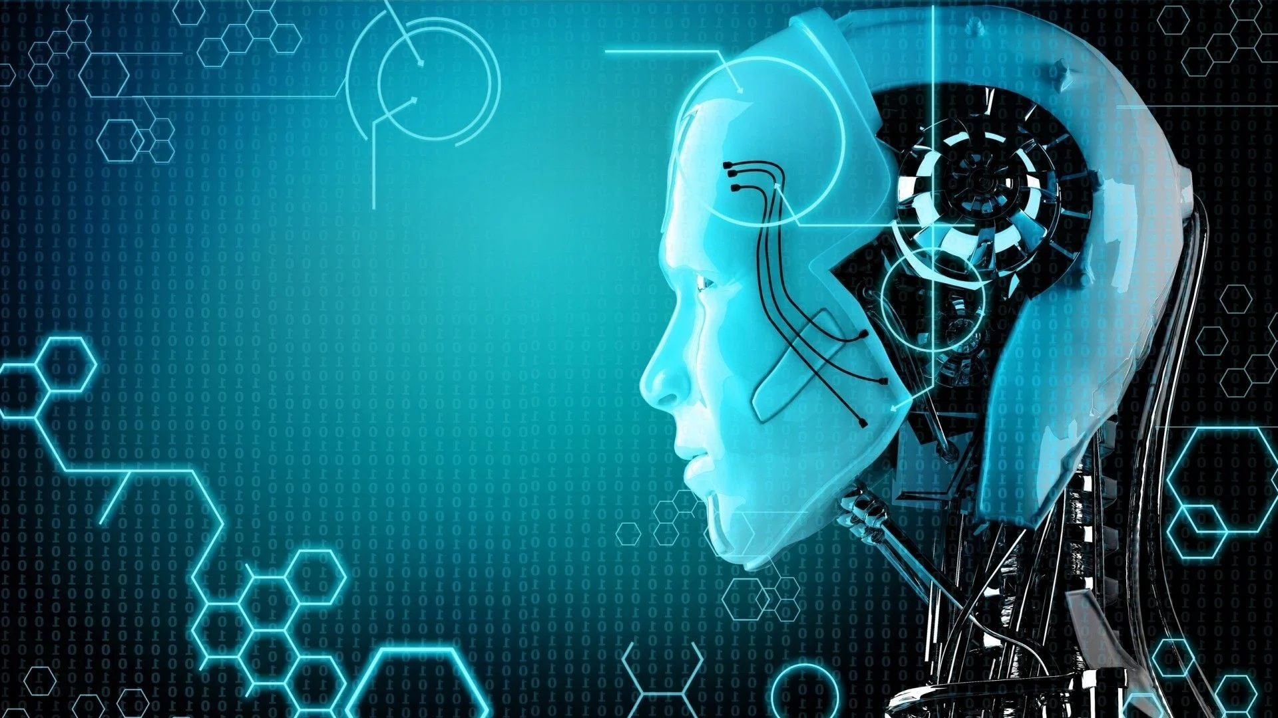
AI for all
Computer Vision >
is a field of AI.
A subset of deep learning.
Library in Python (cv2)

Slide 2
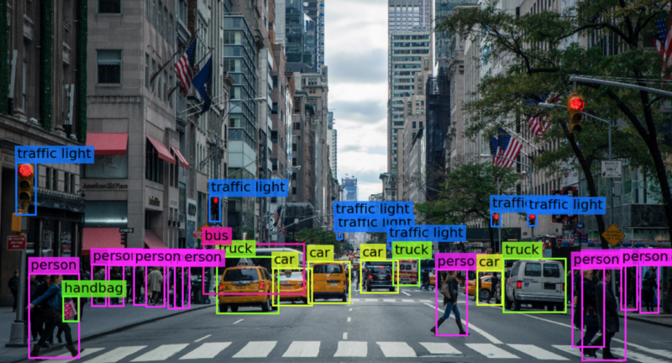
AI for all

Slide 3
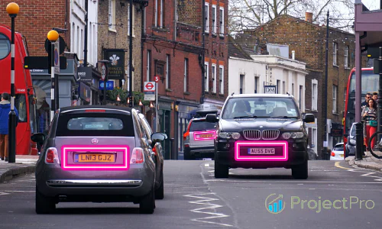
AI for all

Slide 4
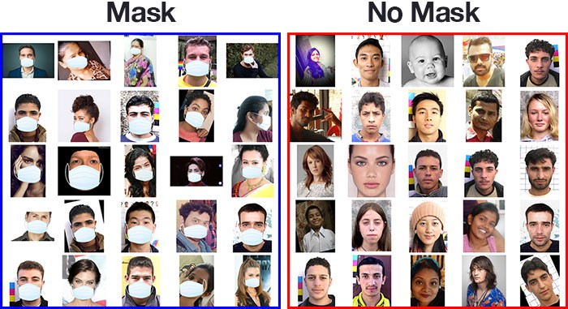
AI for all

Slide 5
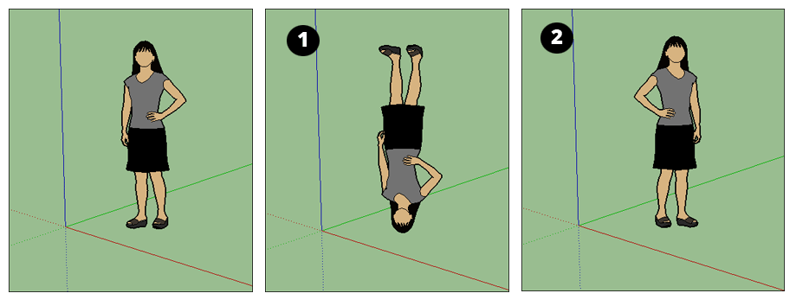
AI for all

Slide 6
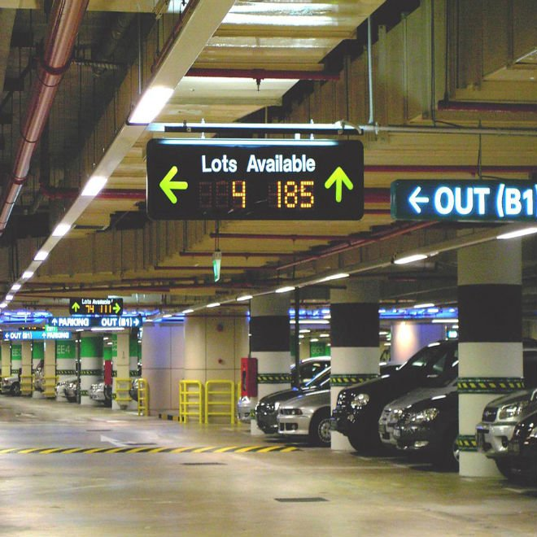
AI for all

